Slide 1


AIML Online Capstone Project AUTOMATIC SUPPORT TICKET ASSIGNMENT
GitHub link
Prasad Darbhamulla
Anil Potukuchi
Niranjan
Ram R
Atanu Sinha
Bruno Suresh Lucas
Date of Submission(Interim) : 05-Jul-2020

Slide 2
Business Case
Background:
In the support process, incoming incidents are analyzed and assessed by organization’s support teams to fulfill the request.
Better allocation and effective usage of the valuable support resources will directly result in substantial cost savings.
Currently, the incidents are created by various stakeholders and are assigned to L1/L2 teams.
Incase L1 / L2 is unable to resolve, they will then escalate / assign the tickets to Functional teams from Applications and Infrastructure (L3 teams).
Problem Statement:
L1 / L2 needs to spend time reviewing Standard Operating Procedures (SOPs) before assigning to Functional teams (Minimum ~25-30% of incidents needs to be reviewed for SOPs before ticket assignment).
15 min is being spent for SOP review for each incident. Minimum of ~1 FTE effort needed only for incident assignment to L3 teams.
Multiple instances of incidents getting assigned to wrong functional groups (Around ~25%)
Additional effort needed for Functional teams to re-assign to right functional groups.
During this process, some of the incidents are in queue and not addressed timely resulting in poor customer service.

Slide 3




















IT Incident Management Framework
54% tickets are resolved by L1/L2 teams
46% tickets are resolved by L3 teams
Email
Communication back to user
Resolution
Resolution
Common Ticket Pool
(Help Desk)
~25-30% of incidents needs to be reviewed (15mis) for SOPs before ticket assignment.
Business Systems
Specialist
~25% of wrong Assignment
Business User
/IT Users
ERP Solutions
team
Phone
Network COE
team
Warehousing
Solutions
Web Apps &
Monitoring tools
Database
App Dev
Team
IT Service Management
& Orchestration Platform
Additional efforts for
re-assignment
Cloud Infra
Team
Categorization
Login
Network
CRM
General IT
Engg. Tool
ERP
Job
Mobility
Hardware
Etc...,
Finance System
Specialists
Ticketing System
HR Solutions team
Support Teams
L1
L2
L3

Slide 4
Challenges
Multiple Languages
Multiple reception modes
Email, Call, Chat, Monitoring tools, Direct entry into system
Length of the sentences is too sparse ( description ranging from few words to several hundreds)
Too many resolution groups – 74 assignment groups, some of them having very few tickets assigned

Slide 5
Project Objective
Guided by powerful AI techniques
Classify incidents to right functional groups based on User description
Help organizations to reduce the resolving time
Improve productivity of Support teams
Automate Assignment process
Support ticket Creation
Email
Phone
Assignment
Common Group
Specific Group
Resolution
Resolution by L1
Ticketing Platform
Auto Email from Monitoring tools
Categorization
IT related
Functional
Specialization
..etc....
Escalation
Resolution by L2
Resolution by L3

Slide 6


Project Timelines
We are
here
Interim report
submission
Final report
submission
Milestone-1
Review progress of team & individuals' contributions, Pointing out errors, suggesting alternative methods, clarification of conceptual roadblocks if any.
Milestone -2
30-May-2020
Final model tuning and documentation. Validation of the final report before submission
Start of Capstone Project
Milestone -1
Release the Capstone problem statement & Grouping
Validate the interim submission and suggest improvements if any. Raise alarms for proactive correction
20-Jun-2020
15-May-2020
Closure of Project
Milestone -1
06-Jun-2020
Discussion of Problem Statement, Delegation of responsibilities among team members, Planning and approach to capstone
Milestone -2
Milestone -2
Evaluation of your model (Comparison of different models, performance tuning)
Presentation of project by
students to mentor
Start
23-May-2020
13-Jun-2020
27-Jun-2020
Week-0 |  |  |  |  |  |  | Week-1 |  |  |  |  |  |  | Week-2 |  |  |  |  |  |  | Week-3 |  |  |  |  |  |  | Week-4 |  |  |  |  |  |  | Week-5 |  |  |  |  |  |  | Week-6 |  |  |  |  |  |  | Week-7
15-May-20 | 16-May-20 | 17-May-20 | 18-May-20 | 19-May-20 | 20-May-20 | 21-May-20 | 22-May-20 | 23-May-20 | 24-May-20 | 25-May-20 | 26-May-20 | 27-May-20 | 28-May-20 | 29-May-20 | 30-May-20 | 31-May-20 | 01-Jun-20 | 02-Jun-20 | 03-Jun-20 | 04-Jun-20 | 05-Jun-20 | 06-Jun-20 | 07-Jun-20 | 08-Jun-20 | 09-Jun-20 | 10-Jun-20 | 11-Jun-20 | 12-Jun-20 | 13-Jun-20 | 14-Jun-20 | 15-Jun-20 | 16-Jun-20 | 17-Jun-20 | 18-Jun-20 | 19-Jun-20 | 20-Jun-20 | 21-Jun-20 | 22-Jun-20 | 23-Jun-20 | 24-Jun-20 | 25-Jun-20 | 26-Jun-20 | 27-Jun-20 | 28-Jun-20 | 29-Jun-20 | 30-Jun-20 | 01-Jul-20 | 02-Jul-20 | 03-Jul-20 | 04-Jul-20 | 05-Jul-20
Milestone1 : Understanding Business case, Project Objective, Data Pre-Processing, EDA, Basic model Building
Milestone2 : Model Evaluation, Model Tuning, Final Document preparation and Report submission

Slide 7
Input Data Analysis
There are total 8500 records in the given dataset and 4 columns namely
Short description
Description
Caller
Assignment group
It seems like GRP_0 and GRP_8 are L1/L2 Groups
Count of Short description | Count of Description | Count of Caller | Count of Assignment group
8498 | 8499 | 8500 | 8500
Top 11 Short Description | Count of tickets
password reset | 38
windows password reset | 29
account locked in ad | 24
windows account locked | 23
erp SID_34 account unlock | 19
unable to connect to vpn | 18
login issue | 18
blank call | 18
account locked. | 18
erp SID_34 password reset | 17
erp access issue | 17
Top 11 Assignment Groups | Count of tickets | %
GRP_0 | 3976 | 46.78%
GRP_8 | 661 | 7.78%
GRP_24 | 289 | 3.40%
GRP_12 | 257 | 3.02%
GRP_9 | 252 | 2.96%
GRP_2 | 241 | 2.84%
GRP_19 | 215 | 2.53%
GRP_3 | 200 | 2.35%
GRP_6 | 184 | 2.16%
GRP_13 | 145 | 1.71%
GRP_10 | 140 | 1.65%

Slide 8
Data – Pre-Processing
Summary :
There are 8500 records in the dataset
Multiple Languages are detected. However, the top Languages are English and German
Both the short and long description translated to English
Special Characters were counted. Records with the no of spl characters more than 50% are deleted.
8 records with null values in short description were deleted.
It was found that the tickets are created through Call, Email, Monitoring Systems, by users directly in the ticketing system or by the agents..
Email id’s were identified from the description column and was stored separately.
Both description and short description are processed and removed of the following things
Sentence trimmed up to “Received From : ”
Email ID
Special characters and excess spaces were removed
Digits, punctuation & HTML tags removed
If caller ID present in the description, it was removed

Slide 9
Data – Pre-Processing
New Columns Created for Analysis :
Column Name | Description | Column Name | Description
Short description | Original | trimmed_words_len | length of trimmed_words
Description | Original | trimmed_words_short | stop words removed from short_desc_en_spl
short_desc_lang | Language of the Short Desc | trimmed_words_long | stop words removed from description_en_spl
short_desc_en | Short Desc translated to English | mark_for_delete | flagged for delete
description_lang | Language of Description | flg_account_related | flg_account_related
description_en | Description Translated to English | flg_job | flg_job
Caller | Original | flg_vpn | flg_vpn
Assignment group | Original | flg_network | flg_network
emails | Email Id from description | flg_erp | flg_erp
email_type | type of email /call | flg_crm | flg_crm
short_desc_spl | Short Desc after removal of spl characters | flg_engineering | flg_engineering
description_spl | Description after removal of spl characters | flg_install | flg_install
short_desc_len | length of Short Desc | flg_laptop | flg_laptop
description_len | lebgth of Description | flg_mobile | flg_mobile
no_of_splch_removed1 | no of spl characters removed from Short desc | flg_outlook | flg_outlook
no_of_splch_removed1_pct | % no of spl characters removed from Short desc | flg_printer | flg_printer
no_of_splch_removed2 | no of spl characters removed from Desc | flg_skype | flg_skype
no_of_splch_removed2_pct | % no of spl characters removed from Desc | flg_ticket_update | flg_ticket_update
short_desc_en_spl | Spl characters removed (short_desc_en) | flg_windows | flg_windows
description_en_spl | Spl characters removed (description_en) | host_related | host_related
short_desc_en_len | length of short_desc_en_spl | blank_call | blank_call
description_en_len | length of description_en_spl | setup_ws | setup_ws
trimmed_words | stop words removed and short_desc_en_spl, description_en_spl combined | flg_help | flg_help
 |  | flg_failed | flg_failed

Slide 10
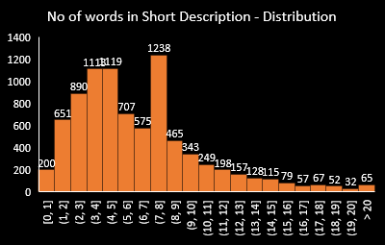
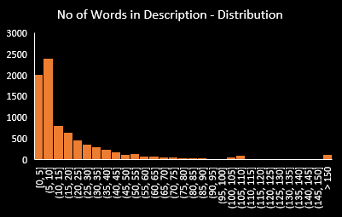
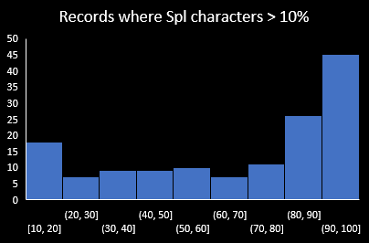
EDA – Exploratory Data Analytics
Majority of the tickets are through calls/direct entry
18% tickets through email (external)
11% tickets are created by monitoring systems
97% of the records belong to English and German
Records with >=50% spl characters (118) were deleted
>10 words : 1191(14%) records
>15 words : 345(4%) records
>20 words : 59(0.69%) words
mean : 6.73 words
median : 6
>50 words : 966(11.36%) records
>100 words : 386(4.54%) records
>200 words : 63(0.74%) words
mean : 25 words
median : 10
54% of the tickets are resolved by Grp_0 and Grp_8. They must be L1/L2 groups. There are 58 Groups in the Others category
95% of the records are having 15 words or less. We can use this as the baseline to trim the sentence
95% of the records are having 100 words or less. We can use this as the baseline to trim the sentence

Slide 11


EDA – With Key words
Key word search done in the Short and Long description and the words are assigned to categories
word | category
access | account/reset/password/login/reset
account | account/reset/password/login/reset
circuit | network
computer | laptop
connection | network
crm | crm
email | outlook
emails | emails
engineering | engineeringtool
engineeringtool | engineeringtool
erp | erp
error | failed
failed | failed
help | help
install | install
issue | failed
job | job
jobscheduler | job
laptop | laptop
locked | account/reset/password/login/reset
login | account/reset/password/login/reset
logon | account/reset/password/login/reset
network | network
outage | network
outlook | outlook
password | account/reset/password/login/reset
passwordmanagementtool | account/reset/password/login/reset
passwords | account/reset/password/login/reset
phone | Mobile
print | printer
printer | printer
problems | failed
reset | account/reset/password/login/reset
server | network
skype | skype
telephonysoftware | mobile
ticket | ticket update
tologin | account/reset/password/login/reset
unable | failed
unlock | account/reset/password/login/reset
update | ticket update
user | account/reset/password/login/reset
vpn | vpn
vpncompanycom | vpn
windows | windows
Row Labels | Count of Final_Flag | Count of Final_Flag2
flg_account_related | 3177 | 37.38%
flg_job | 1006 | 11.84%
None | 807 | 9.49%
flg_failed | 415 | 4.88%
flg_erp | 373 | 4.39%
flg_outlook | 354 | 4.16%
flg_network | 353 | 4.15%
flg_laptop | 316 | 3.72%
flg_ticket_update | 252 | 2.96%
flg_mobile | 220 | 2.59%
flg_printer | 152 | 1.79%
flg_install | 146 | 1.72%
flg_vpn | 136 | 1.60%
flg_engineering | 129 | 1.52%
mark_for_delete | 118 | 1.39%
flg_crm | 117 | 1.38%
host_related | 117 | 1.38%
flg_help | 114 | 1.34%
flg_skype | 100 | 1.18%
blank_call | 43 | 0.51%
setup_ws | 33 | 0.39%
flg_windows | 22 | 0.26%
Grand Total | 8500 | 100.00%
Dataset is enriched with the following flags to understand the correlation between the categories and the Assignment Groups
Group-4

Slide 12
EDA – With Key words

Slide 13
EDA – Summary
Language :
English and German contribute to >97% of all tickets. Google translate is used for English translation
Special Characters :
10% of the records are having at least one Special Character.
Using EDA it was decided that any record having more than 50% of spl characters is not useful for training and hence deleted. For all others, the special characters were removed
Ticket Reception Mode:
Multiple ticket reception modes were detected. Call, direct entry ,Email(internal and external) and monitoring tools.
It is important to note that monitoring tools can directly assign a ticket to L2/L3 based on the severity/priority.
Assignment Groups :
As detected in the beginning 54% of the tickets are resolved by L1/L2 groups ( Grp_0 and Grp_8).
There are total 74 groups in the dataset.
9 out of 74 groups manage 75% of the tickets. So the distribution is very sparce.
At the tail end there are 41 groups managing 5% of the total tickets.
We need to club all these groups into one group called “Others” as it is impossible to train using this dataset.
Word Count :
No of words in both the short description and Description has wide distribution. Using EDA we concluded to limit the no of words in Short description and Description as 15 and 100
Short description : >15 words : 345(4%) records
Description : >100 words : 386(4.54%) records

Slide 14
EDA – Summary (Contd..)
Key words :
Key words were identified using word frequency (tokenization). Tickets are categorized based on the key words Interesting results were observed
Top categories are “account/password related” and “job related”. Both of them account for 49% of the tickets followed by “erp”, “outlook”, “network related”..etc.........,
Analysis of Assigned group vs the ticket category “flg_account related” resulted in 73% of the user account related tickets are handled by 3 groups ( GRP_0, GRP_2, GRP_8).
88% of job-related tickets are handled by 5 groups (Grp_8, Grp_9, Grp_6, Grp_5, Grp_10)
There were 9% of tickets where none of the key words were available
Key word analysis gave us interesting insights. Traditional automations uses the key word search to find the best fit category for a ticket assignment. This method has its own limitations. Unless the context is understood, it is not possible to assign a ticket to a particular group.
We can see this in the “flg_account_related” tickets. In the outset it may look like the tickets need to be assigned to L1/L2 but, only 73% of the tickets were resolved by them and the rest by L3.
It’s time we use advanced analytical techniques. New forms of AIML will go beyond the simple keyword search used by traditional methods. Using NLP and deep learning, tickets can be tagged/classified based on topic, issues, intent, sentiment or priority. We can use the tags within support software in combination with routing and prioritization rules.
It’s important that we make this leap to truly intelligent ticket classification because we are quickly dealing with lot of tickets and different varieties.

Slide 15



Basic Model Building – Comparing different Options
Model | Advantages | Limitations | Remark
Simple Rule Based Automation (Key word search) | Easy to automate Easy to understand the logic of classification Can be incorporated in the existing | Key words and rules keep changing Complex when reception modes are multiple Multiple languages makes it even more complicated Context is not considered | This is a traditional automation technique and is not very efficient
Basic Machine Learning (Extract features using NLP and build an ML model using ensemble or other techniques) | Simple models can be built using past data Faster training | Feature extraction makes the model rigid. Complicated when reception modes are multiple (Email/Chat/Call..Etc.......) Context is missing | This is not suitable since the context is missing in the model and new features need to be added frequently
Neural Networks with NLP (Bag of words) | Perform better than simple ML models. Can be used to train deeper | Ordinary Neural Networks don’t perform well in cases where sequence of data is important. | Since the sequence of data is important ( especially with multiple reception modes), we can not get better results
Simple RNN’s (Recurring Neural Networks) | An RNN cell not only considers its present input but also the output of RNN cells preceding it, for its present output. Understands the context | Vanishing gradients problem Exploding gradients problem Long-Term Dependencies problem | RNN is the answer for our problem. However, simple RNN may not work due to the mentioned disadvantages
Special RNN’s ( LSTM ) | capability of handling Long-Term dependencies. Provide solution to Vanishing/Exploding Gradient problem | Difficult to train because they require memory-bandwidth-bound computation, which is the worst nightmare for hardware designer Limits the applicability of neural networks solutions based on Hardware | We are going to start building a basic model using LSTM and establish baseline accuracy Do simulations with different combinations to get the best possible accuracy
Advanced Architectures ( BERT, ELMO..etc....) | More efficient than LSTM |  | Need to be explored

Slide 16
Basic Model Building - LSTM
Ordinary Neural Networks don’t perform well in cases where sequence of data is important. To overcome this, RNNs were invented. RNN stands for “Recurrent Neural Network”. An RNN cell not only considers its present input but also the output of RNN cells preceding it, for its present output.
It is proved that RNNs perform very well on sequential data and on tasks where sequence was important. In ticket classification, sequence of the words is important to understand the right classification and severity of the issue so that the ticket can be assigned to the right resolution group ( L1/L2/L3)
But there exists many problems with ordinary RNNs
Vanishing gradients problem : During backpropagation, as gradient is calculated by chain rule, it has an effect of multiplying these small numbers which squeezes the final gradient to almost zero and hence subtracting gradient from weights doesn’t make any change to them which stops the training of model.
Exploding gradients problem : Opposite to vanishing gradient problem, while following chain rule we multiply with the weight matrix too at each step, and if the values are larger than 1, multiplying a large number to itself many times leads to a very large number leading to explosion of gradient.
Long-Term Dependencies problem : RNNs are good in handling sequential data but they run into problem when the context is far away.
Long Short Term Memory Networks : LSTMs are special kind of RNNs with capability of handling Long-Term dependencies. LSTMs also provide solution to Vanishing/Exploding Gradient problem. A simple LSTM cell looks like this

Slide 17
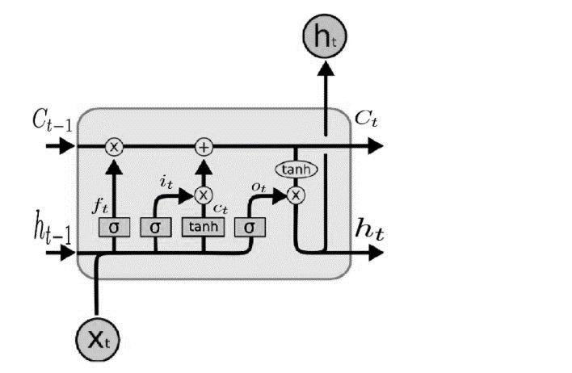
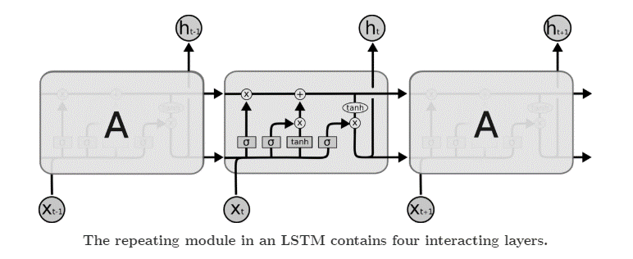
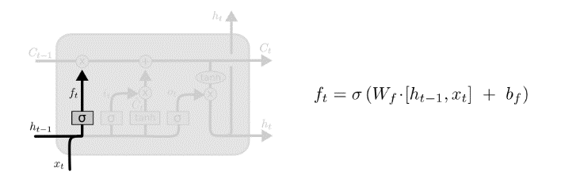
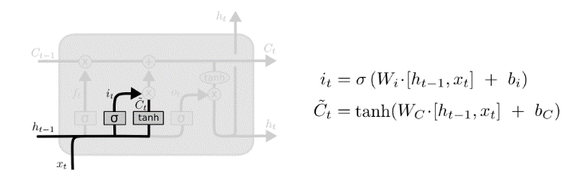
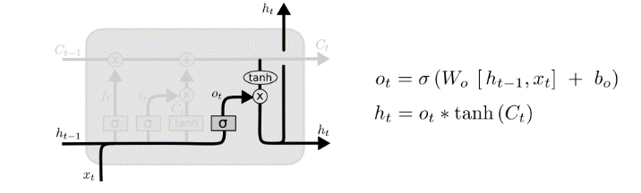
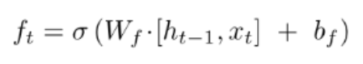
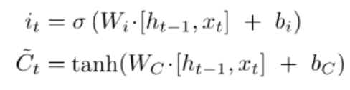
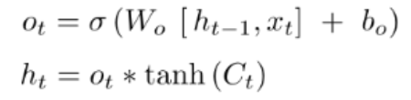
Basic Model Building – LSTM Architecture
LSTM Cell
f: Forget gate : Where to erase cell
i: Input Gate, whether to write to cell
g: Gate gate(?), how much to write to cell
o : Output gate, How much to reveal cell
Forget Gate: After getting the output of previous state, h(t-1), Forget gate helps us to take decisions about what must be removed from h(t-1) state and thus keeping only relevant stuff. It is surrounded by a sigmoid function which helps to crush the input between [0,1]
Input Gate: In the input gate, we decide to add new stuff from the present input to our present cell state scaled by how much we wish to add them. In the above photo, sigmoid layer decides which values to be updated and tanh layer creates a vector for new candidates to added to present cell state
Output Gate: Finally we’ll decide what to output from our cell state which will be done by our sigmoid function.
We multiply the input with tanh to crush the values between (-1,1) and then multiply it with the output of sigmoid function so that we only output what we want to.

Slide 18
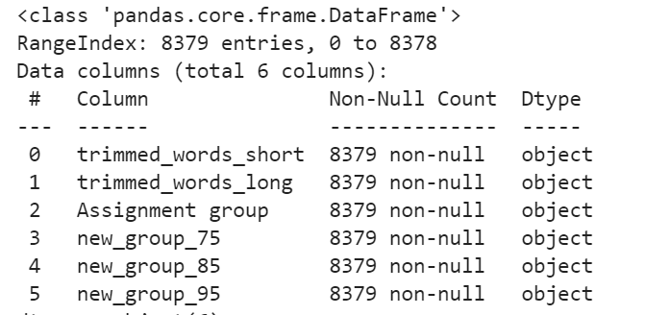
Data Preparation for Model Building
We created the below 5 columns from our dataset for model building
trimmed_words_short : Processed data from the original Columns “Short description”
trimmed_words_long : Processed data from the original column Description
Assignment group : Original column “Assignment group”
new_group_75 : There are groups which contribute to 75% tickets. Rest all groups are clubbed as Others
new_group_85 : There are groups which contribute to 85% tickets. Rest all groups are clubbed as Others
new_group_95 : There are groups which contribute to 95% tickets. Rest all groups are clubbed as Others
We are going to run the model with all the possible
combinations of trimmed_words_shot/trimmed_words_long
and the 4 different assignment groups

Slide 19
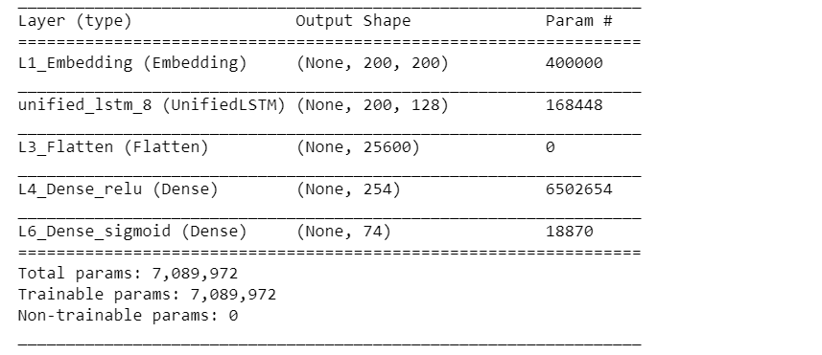
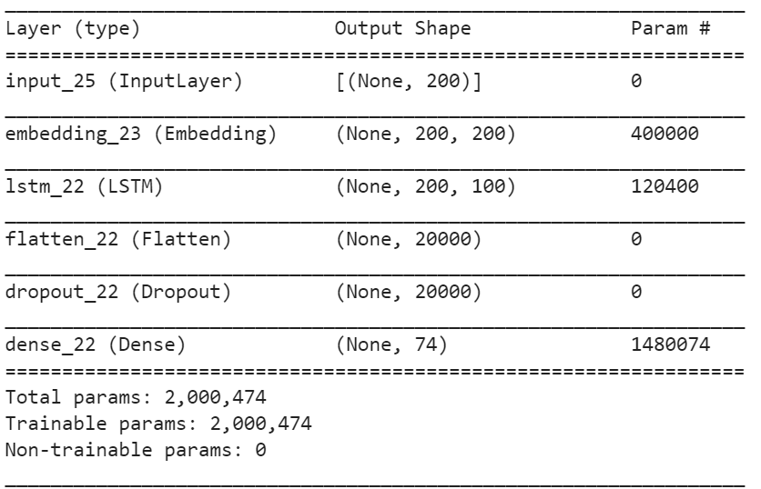
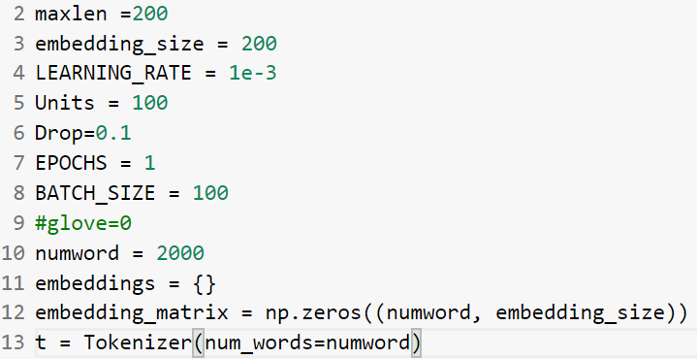
Basic Model Building – LSTM Architecture
Run the model –
Without any weight matrix
With pre-trained GloVe vector

Slide 20
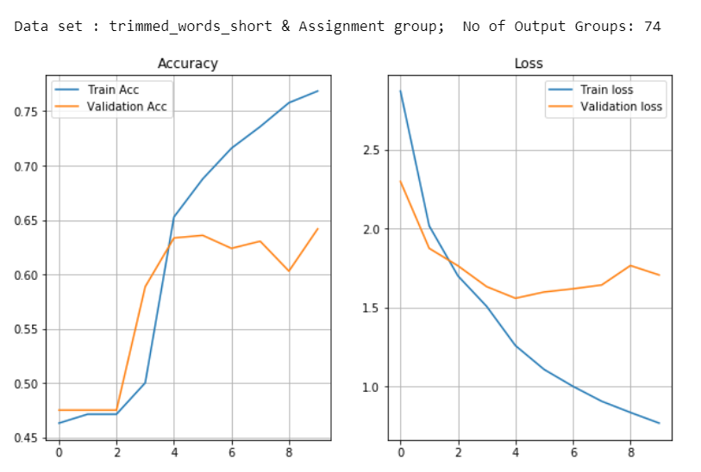
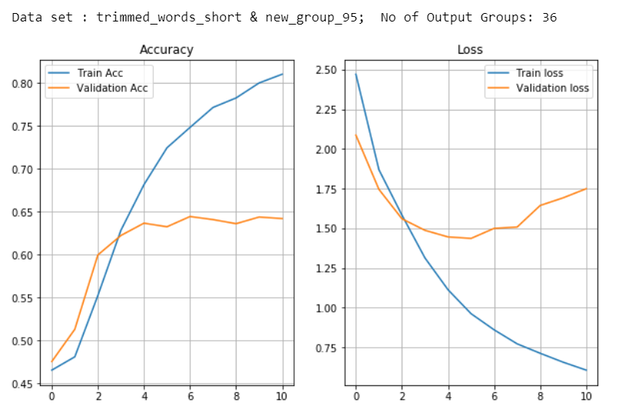
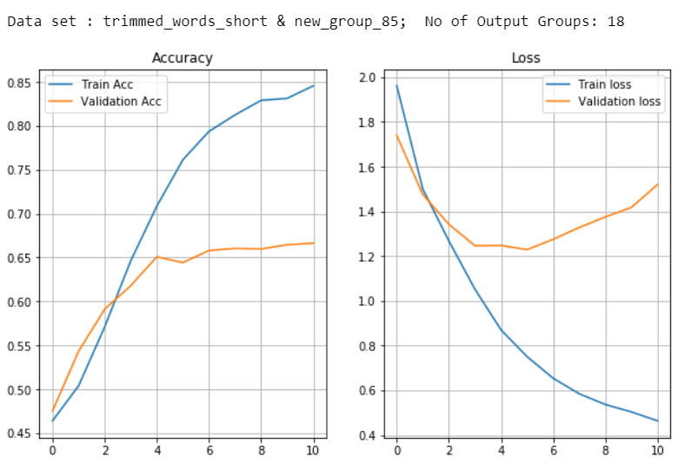
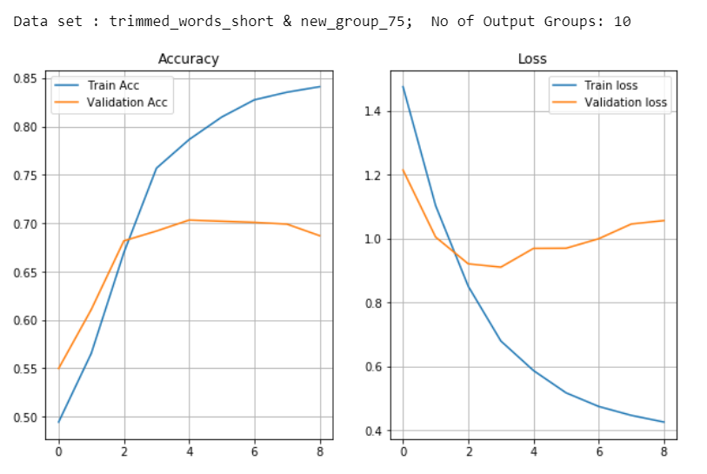
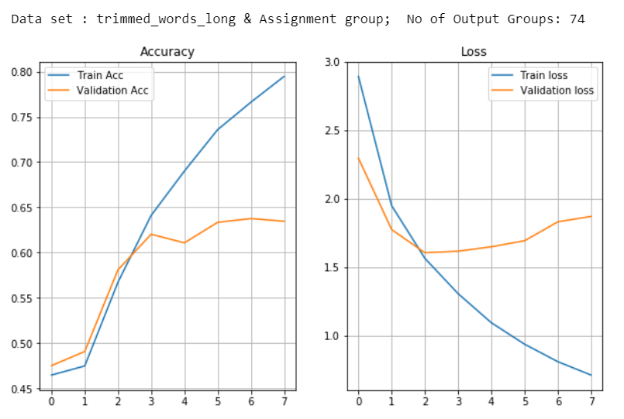
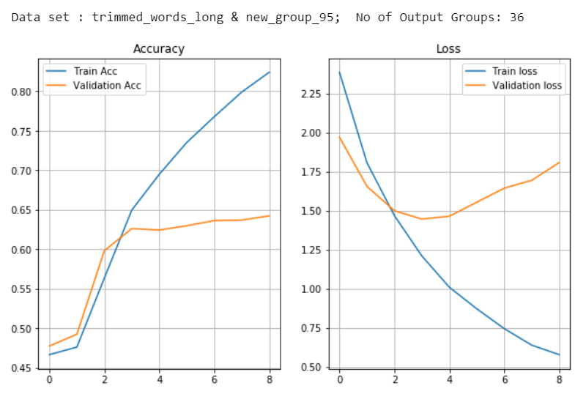
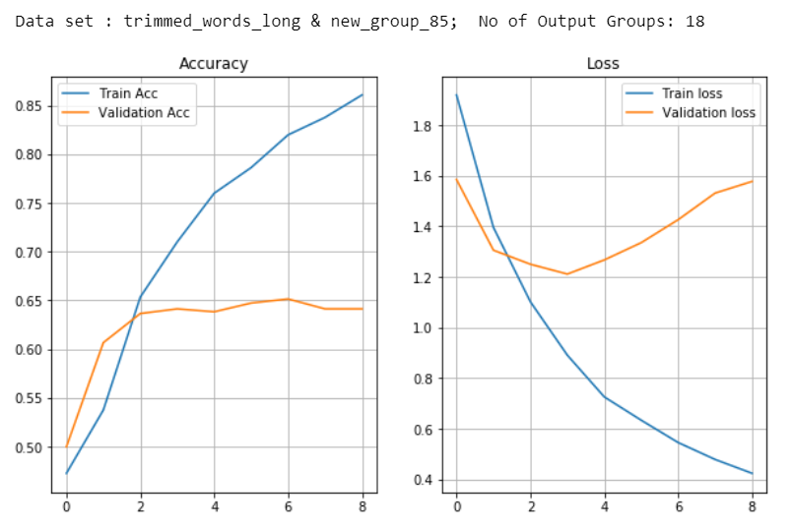
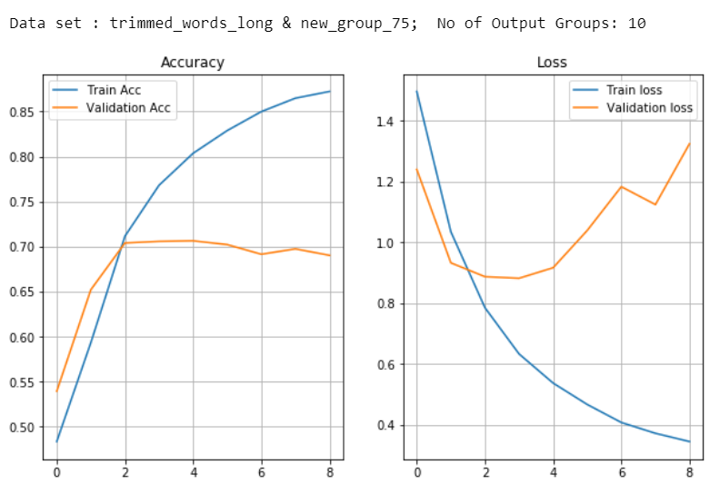
Basic Model Building – Accuracy/Loss plots
Model built with out any pre-trained weights in the Embedding layer
Training Accuracy : 77%
Validation Accuracy : 64%
No of Epochs : 9
Training Accuracy : 81%
Validation Accuracy : 64%
No of Epochs : 10
Training Accuracy : 85%
Validation Accuracy : 67%
No of Epochs : 10
Training Accuracy : 84%
Validation Accuracy : 70%
No of Epochs : 8
Training Accuracy : 79%
Validation Accuracy : 64%
No of Epochs : 7
Training Accuracy : 82%
Validation Accuracy : 64%
No of Epochs : 8
Training Accuracy : 86%
Validation Accuracy : 65%
No of Epochs : 8
Training Accuracy : 87%
Validation Accuracy : 71%
No of Epochs : 8

Slide 21
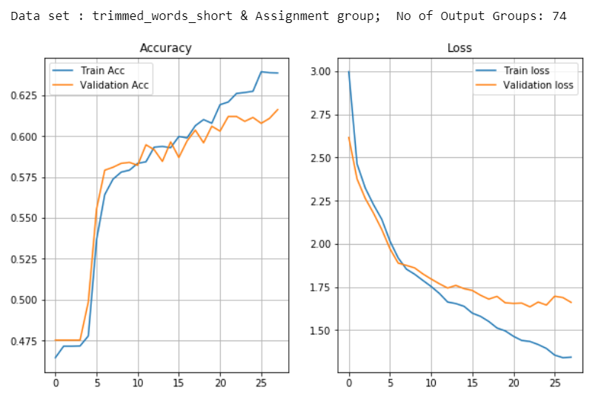
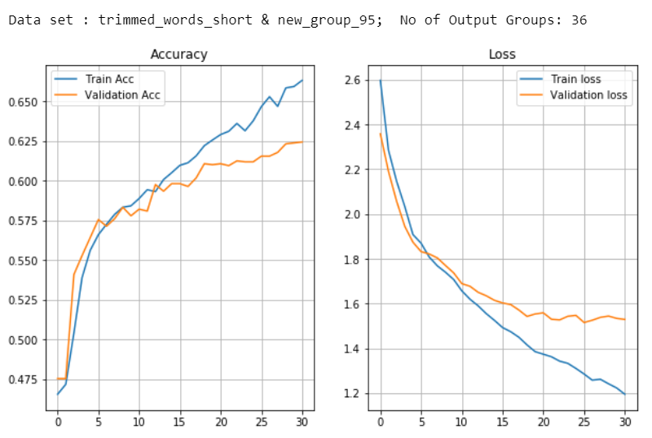
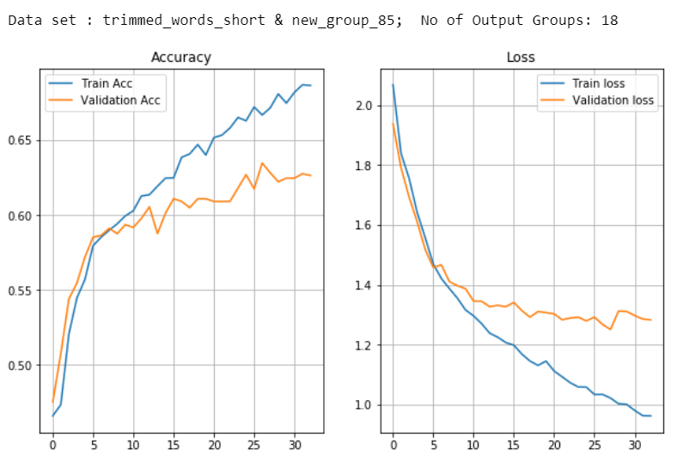
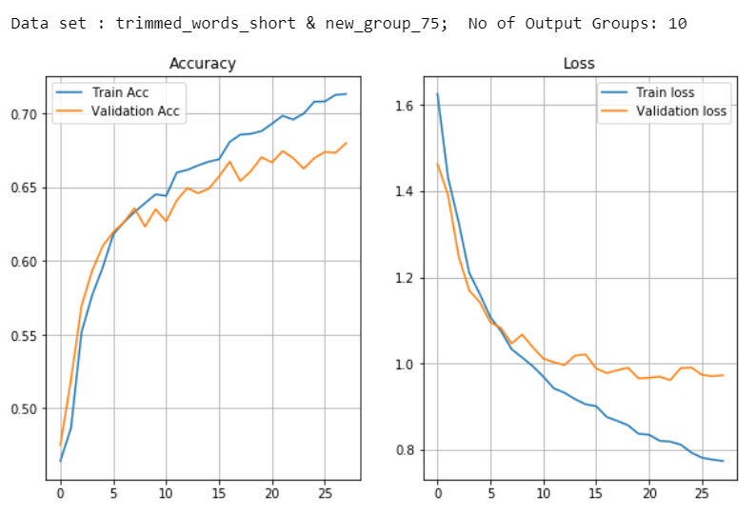
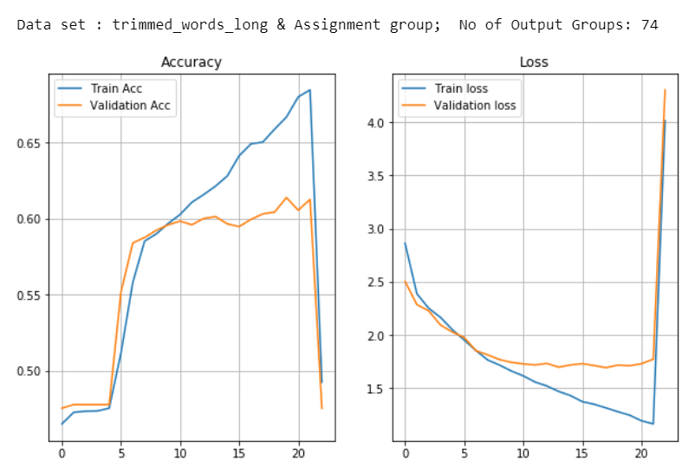
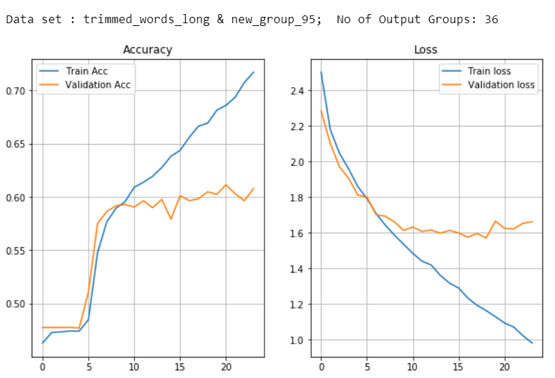
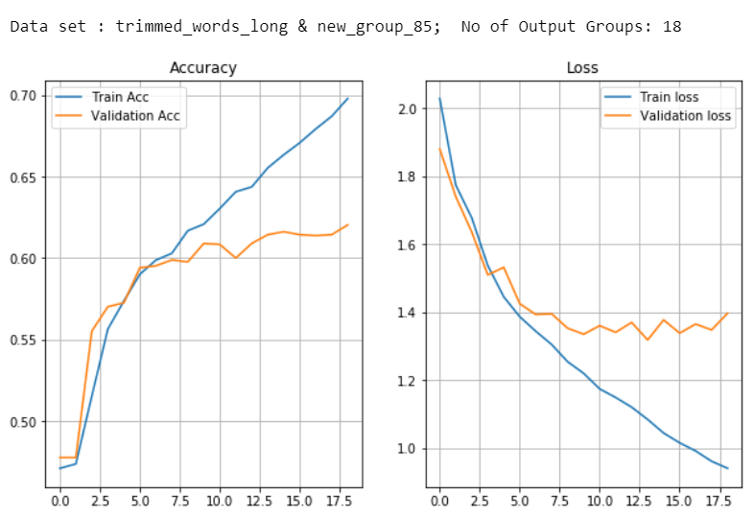
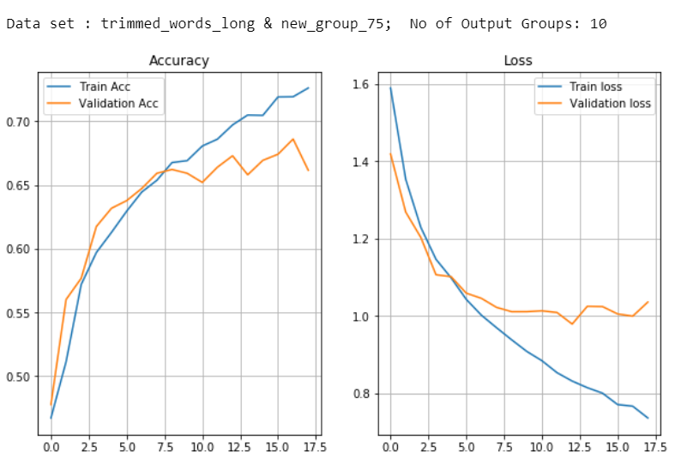
Basic Model Building – Accuracy/Loss plots
Model built using pre-trained GloVe Vector in the Embedding layer
Training Accuracy : 64%
Validation Accuracy : 62%
No of Epochs : 27
Training Accuracy : 66%
Validation Accuracy : 62%
No of Epochs : 30
Training Accuracy : 69%
Validation Accuracy : 63%
No of Epochs : 32
Training Accuracy : 71%
Validation Accuracy : 68%
No of Epochs : 27
Training Accuracy : 68%
Validation Accuracy : 61%
No of Epochs : 22
Training Accuracy : 72%
Validation Accuracy : 61%
No of Epochs : 23
Training Accuracy : 70%
Validation Accuracy : 62%
No of Epochs : 18
Training Accuracy : 73%
Validation Accuracy : 69%
No of Epochs : 17

Slide 22
Basic Model Building – Baseline Results
Model results with out using GloVe Vector
 | Description Col | Group Col | Dense Group | Training Acc | Validation Acc | Training Loss | Validation Loss
0 | trimmed_words_short | Assignment group | 74 | 0.77 | 0.64 | 2.87 | 2.3
3 | trimmed_words_short | new_group_95 | 36 | 0.81 | 0.64 | 2.47 | 2.09
2 | trimmed_words_short | new_group_85 | 18 | 0.85 | 0.67 | 1.96 | 1.74
1 | trimmed_words_short | new_group_75 | 10 | 0.84 | 0.7 | 1.48 | 1.21
4 | trimmed_words_long | Assignment group | 74 | 0.79 | 0.64 | 2.89 | 2.3
7 | trimmed_words_long | new_group_95 | 36 | 0.82 | 0.64 | 2.39 | 1.97
6 | trimmed_words_long | new_group_85 | 18 | 0.86 | 0.65 | 1.92 | 1.59
5 | trimmed_words_long | new_group_75 | 10 | 0.87 | 0.71 | 1.5 | 1.32
Model results using GloVe Vector
 | Description Col | Group Col | Dense Group | Training Acc | Validation Acc | Training Loss | Validation Loss
0 | trimmed_words_short | Assignment group | 74 | 0.64 | 0.62 | 3 | 2.62
3 | trimmed_words_short | new_group_95 | 36 | 0.66 | 0.62 | 2.6 | 2.36
2 | trimmed_words_short | new_group_85 | 18 | 0.69 | 0.63 | 2.07 | 1.94
1 | trimmed_words_short | new_group_75 | 10 | 0.71 | 0.68 | 1.63 | 1.46
4 | trimmed_words_long | Assignment group | 74 | 0.68 | 0.61 | 4.01 | 4.3
7 | trimmed_words_long | new_group_95 | 36 | 0.72 | 0.61 | 2.5 | 2.28
6 | trimmed_words_long | new_group_85 | 18 | 0.7 | 0.62 | 2.03 | 1.88
5 | trimmed_words_long | new_group_75 | 10 | 0.73 | 0.69 | 1.59 | 1.42

Slide 23
Observations :
Using ‘Long Description’ we got better accuracy than the short description. However, the difference between training accuracy and validation is higher in case of long description, understandably due to the sparsity of the data.
We need to find ways to use information from both the short and long description to improve the model further
When the model was run without pre-trained weight matrix in the embedding layer, model got overfit very quickly just in 8 to 10 Epochs. Also, we found that there is a wide gap between the training accuracy and the validation accuracy.
However, when the model was built using GloVe pre-trained matrix, we got lesser accuracy, but generalization loss is lower indicating the model is getting robust.
We got best accuracy with the target variable “assignment_group_75” which is having only 10 output groups (75% tickets are assigned to 9 groups and rest all the 65 groups were clubbed under others)
Notes:
Accuracy was better but generalization loss was lower indicating the model is getting more robust

Slide 24
How to Improve Model Accuracy Further ?
Try the below model combinations
Bi-LSTM with CNN Layer
Modified Encoder-Decoder Network
Modified Encoder-Decoder Network with Additional Features extracted from text
Modified Encoder-Decoder Network with Attention layer

Slide 25
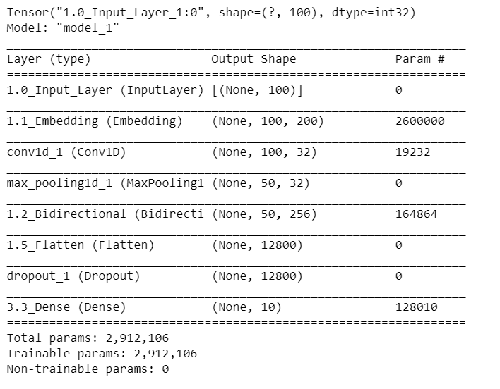
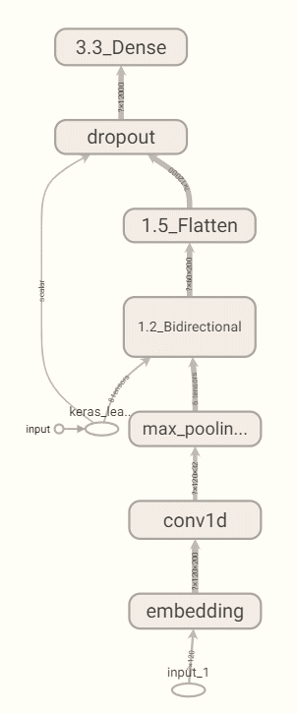
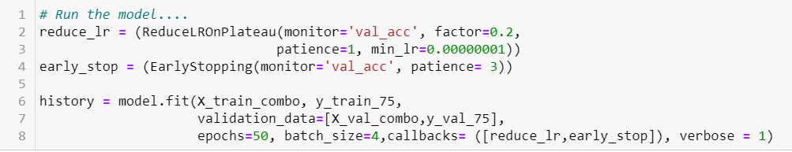
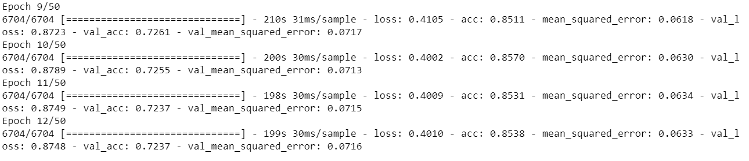
Bi-LSTM with CNN layer
The combination of CNN and RNN models proved to be effective, since each model has a specific architecture and its own strengths:
CNN is known for its ability to extract as many features as possible from the text.
LSTM/Bi-LSTM keeps the chronological order between words in a document, thus having the ability to ignore unnecessary words using the delete gate.
The purpose of combining these two models is to create a model that takes advantage of the strengths of CNN and BiLSTM, so that it captures the features extracted using CNN, and uses them as an LSTM input.
We develop a model that meets this objective, such that the vectors built in the word embeddings are used as convolutional neural network input. Then, the results of all max pooling layers are concatenated to build the BiLSTM input, which applies a BiLSTM layer to filter the information, using its three gates.
The output of this step is the input of the fully connected layer, which links each piece of input information with a piece of output information. Finally, we apply the sigmoid function as an activation function to assign classes

Slide 26
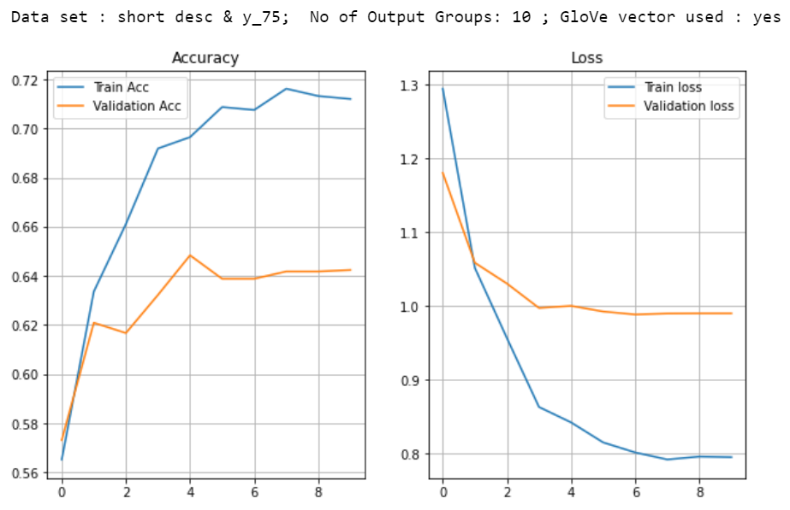
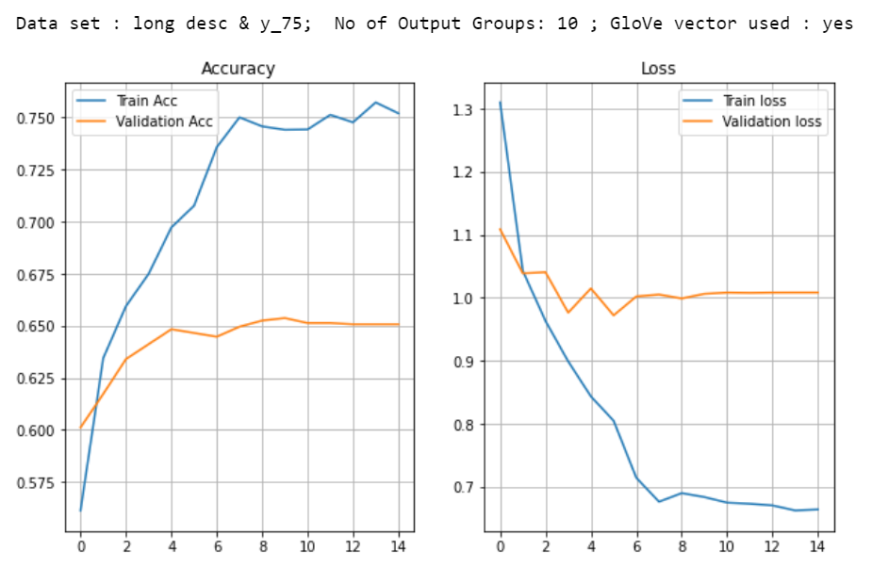
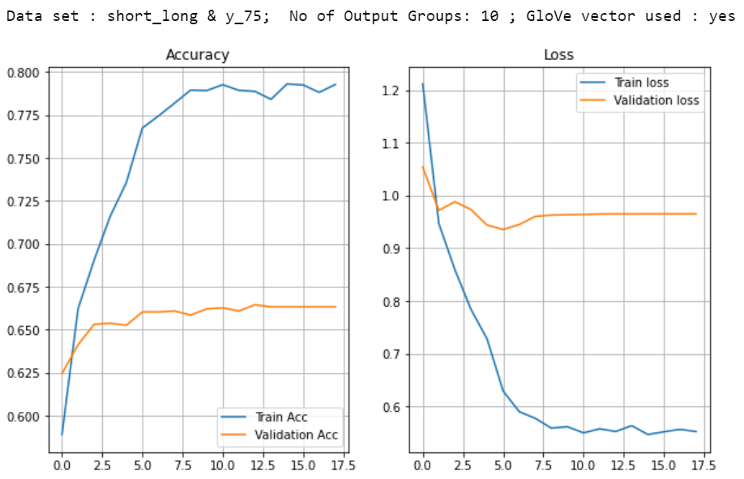
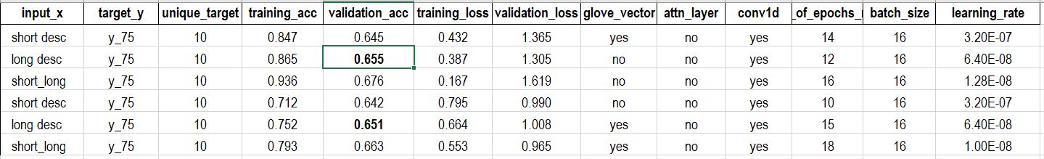
Bi-LSTM with CNN layer
Observations : It was observed that the model was not able to improve the accuracy beyond 65% and running the model further is quickly overfitting. It seems the model is not able to understand the context of the text and hence failing beyond
a point to improve the accuracy. Adding attention layer or an Encoder/Decoder network may help to improve the accuracy further

Slide 27
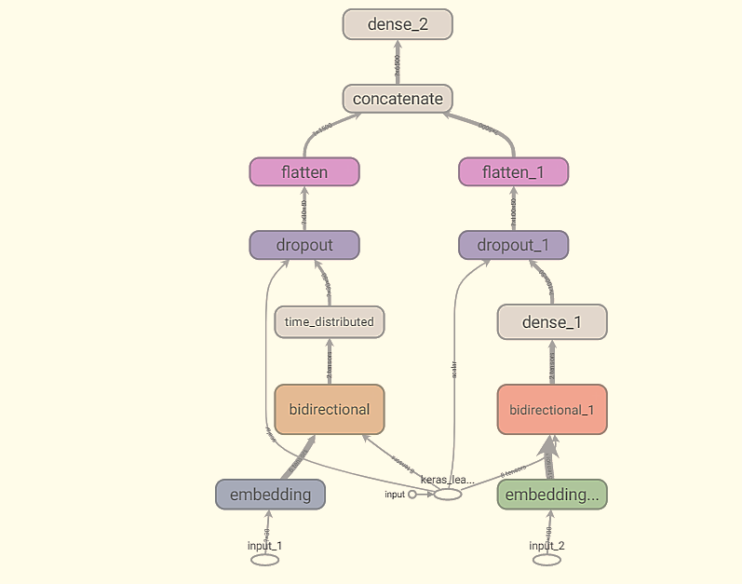
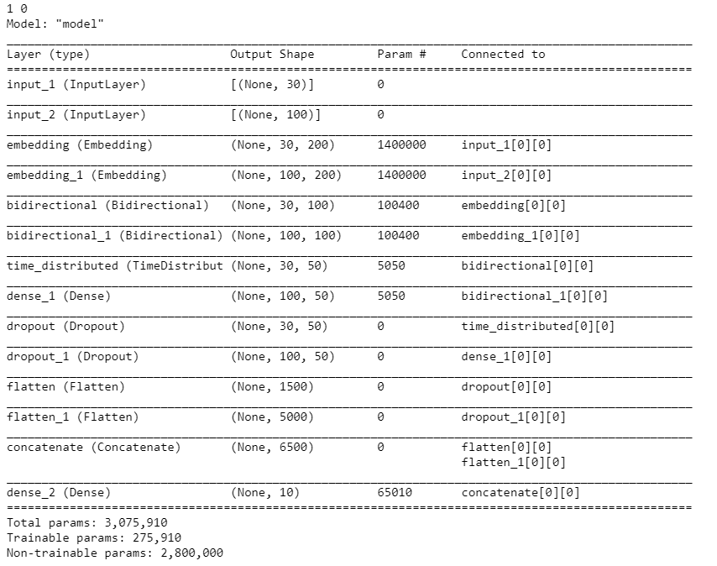
Modified Encoder-Decoder Network
Used a modified encoder-decoder network to take advantage of the both Short and Long descriptions we have in the dataset.
Network is constructed by having a Bi-LSTM and Dense layer for Short description and a similar combination for long description and concatenate both the outputs and have another dense layer.
By doing this we are helping the model to encode the text from both the short and long description and get the flexibility for the model to train using the entire dataset.

Slide 28
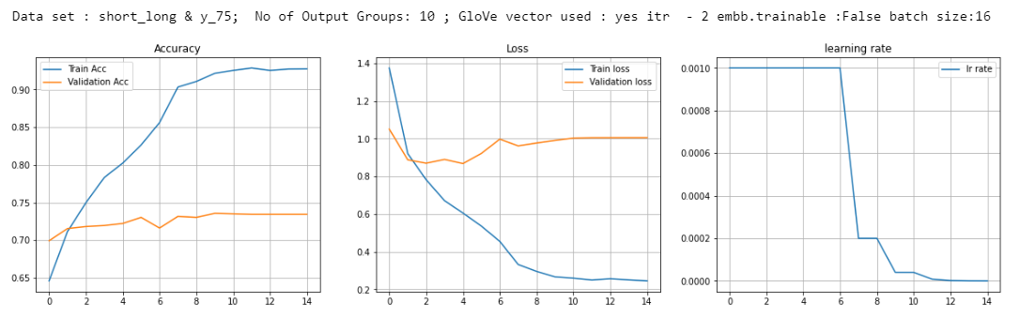
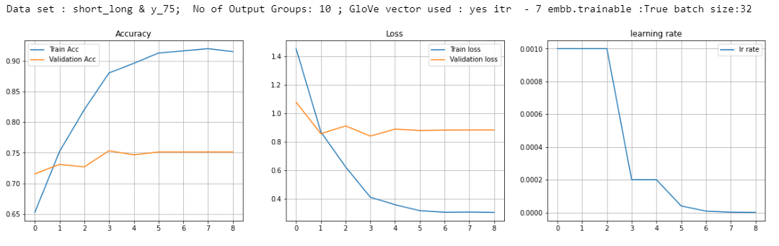
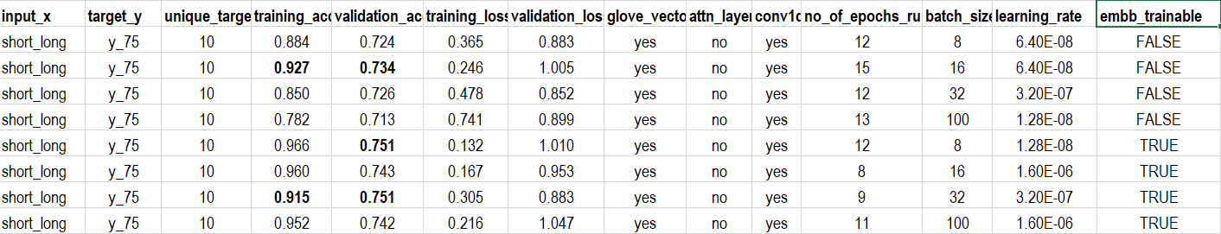
Modified Encoder-Decoder Network
Observations : Model accuracy improved beyond 73%. If we trained the model deeper than 15 epochs, model is getting overfit.

Slide 29
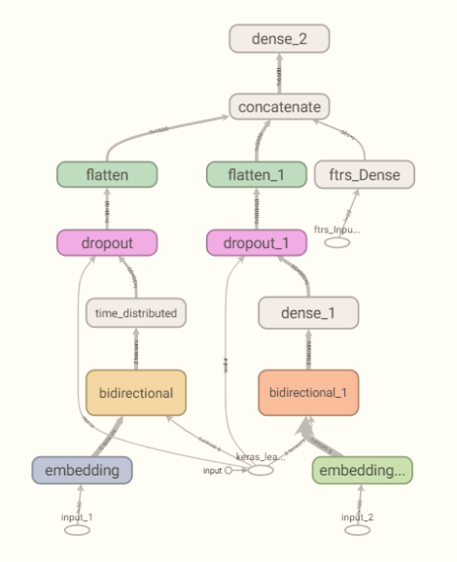
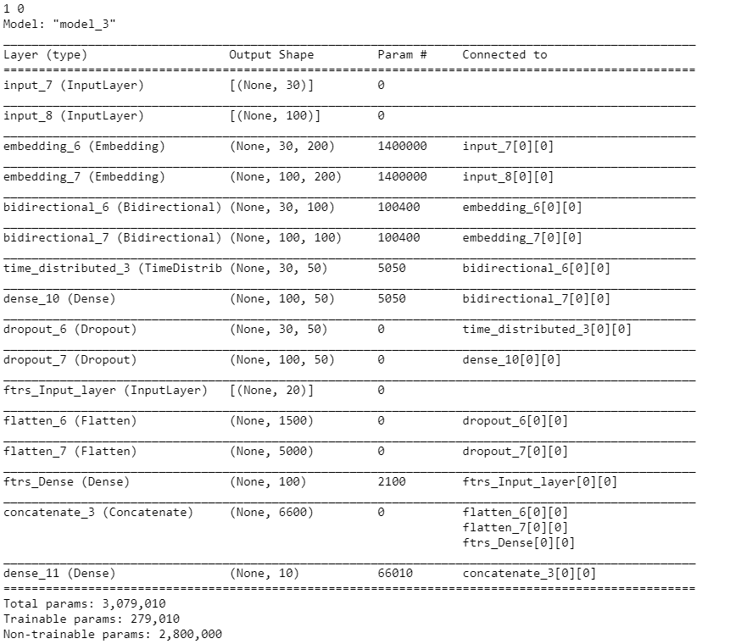
Modified Encoder-Decoder Network With Additional Features
During pre-processing of the data, we extracted several additional features from the text. In this model we will add those features as an additional input and train the model.
The Network diagram on the right side shows the additional input layer added to the model ( 20 features)

Slide 30
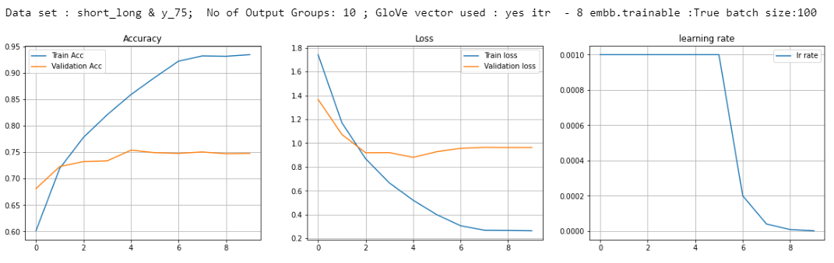
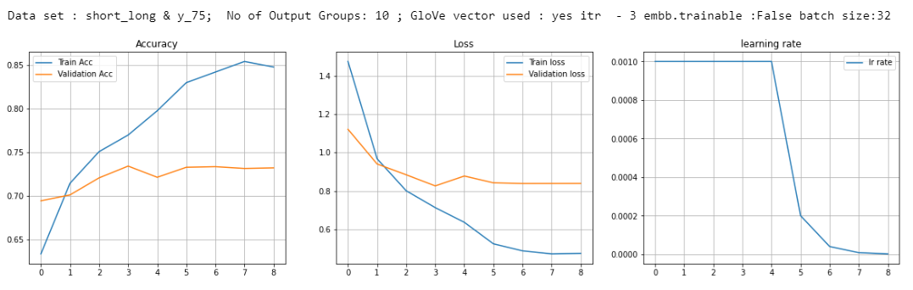
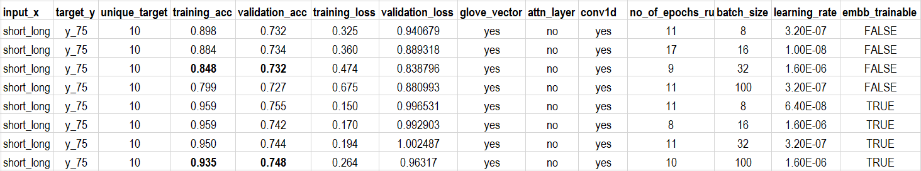
Modified Encoder-Decoder Network With Additional Features
Observations : While the validation accuracy is little lesser than our previous model, it is interesting to note that the model is more robust and generalized compared to the previous one.

Slide 31
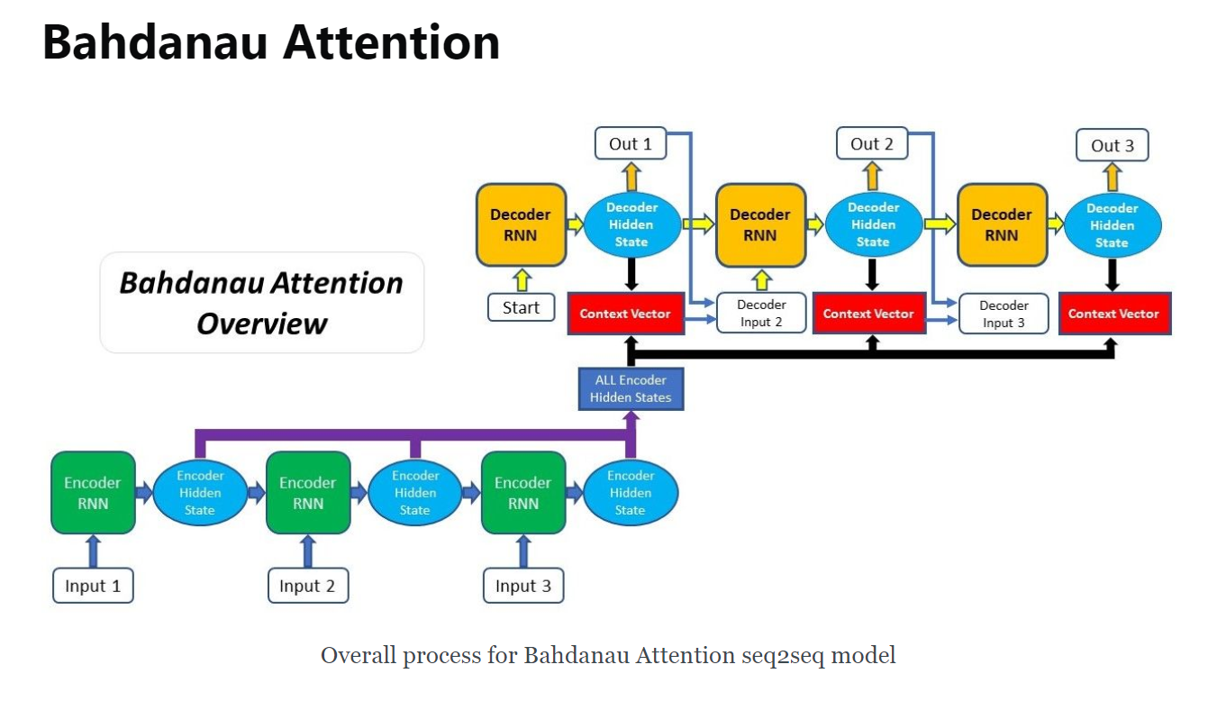
Addition of attention layer to Encoder-Decoder network
The seq2seq models is normally composed of an encoder-decoder architecture, where the encoder processes the input sequence and encodes/compresses/summarizes the information into a context vector (also called as the “thought vector”) of a fixed length. This representation is expected to be a good summary of the entire input sequence. The decoder is then initialized with this context vector, using which it starts generating the transformed output. A critical and apparent disadvantage of this fixed-length context vector design is the incapability of the system to remember longer sequences. Often is has forgotten the earlier parts of the sequence once it has processed the entire the sequence. The attention mechanism was born to resolve this problem.
Source: https://blog.floydhub.com/attention-mechanism/

Slide 32


With Attention Layer
To the above Encoder-Decoder Network, an attention layer is added to understand the impact

Slide 33



With Attention Layer - Results
Observations : The results are similar to the previous model with Encoder-Decoder network with additional features. We haven’t observed significant change in any of the metrics after addition of attention layer. One of the reason could be small amount of dataset.

Slide 34
Try with Elmo Embedding
Elmo Embedding uses context-based word embedding and makes use of bidirectional LSTM to achieve this.
ELMo language model is trained on the 1B Word Benchmark. In addition, the language model really is large-scale with the LSTM layers containing 4096 units and the input embedding transform using 2048 convolutional filters
Current Limitation
Elmo embedding was tried on the dataset, however during the build it was noticed that the TensorFlow Hub Modules for Elmo embeddings are currently not available for TensorFlow 2.0. The 1.x code can be invoked by turning off “eager execution” however this limits us from using the embedding as a layer in our current model.
Thus, it was agreed not to proceed with Elmo embedding as it would require us to convert the entire model to 1.x compatible

Slide 35
Final Model - Modified Encoder-Decoder Network
Based on all the above results, final model selected is Modified Encoder-Decoder network which has 3 input layers
Short Description, Long Description and Extracted features from the text
20 features extracted from both short and long description are passed as an input to boost model
Short Description
long Description

Slide 36



Final Model - Results
Confusion Matrix
Classification Report

Slide 37

Final Model – Examples of correct predictions
Actual
Predicted

Slide 38

Final Model – Examples of incorrect predictions
Actual
Predicted

Slide 39
Challenges faced in improving the accuracy
Even after trying complex models, it was observed that the model is finding it hard to improve the accuracy beyond 72%. While there is an improvement in the overall accuracy from simple LSTM to BiLSTM, CNN+BiLSTM and Encoder-Decoder network, it was observed that beyond 70% accuracy model is struggling to improve without overfitting. Following attempts were made to improve the model accuracy
Tried various combinations of input length for both Short and Long description
Tried combination of both Sort and Long description
Increased num_words during tokenization to maximum
Added the “caller” column to the model to see if the user info improve accuracy
Added additional features extracted from the data as a separate input layer to improve the accuracy
Controlled overfitting through
Adding dropout, recurrent dropout in BiLSTM layers
Dropout after dense layers
Addition of glove vector in the embeddings and making the embedding layer non-trainable
Even after trying all these combinations and running multiple simulations, we could not improve the validation accuracy beyond a maximum of 75%. After thorough investigation we found that the accuracy can only be improved by providing rich and more data. This is explained in detail in the next slide

Slide 40
Challenges faced in improving the accuracy
Data sparsity : Data is extremely sparce where 55% of the data (L1/L2 tickets) belongs to 2 categories and 10% data is spread across 53 categories and 35% of the data belongs to 19 categories.
Small Dataset : For the number of categories in question(74), the data set of 8500 records is very small. Deep learning algorithms are data hungry especially when the no of target categories are high.
Less no of features in the dataset : There are very less no of features in the dataset to make accurate predictions. For example, we are not sure even the classification of the category like L1/L2/L3. Additional features like below will can improve the accuracy dramatically
Classification of the categories into smaller buckets like L1/L2/L3 with few groups within
Additional features of the tickets from the ticketing systems like ticket class, ticket priority..etc....
It is not very clear if the ticket is resolved.
Reception mode of the ticket like Email, Self generated tickets by agents, users entering the tickets directly into system ..etc....
All the ticketing systems today have ability to capture all these features and many more and they help a lot to enrich the data set and there by improve our model performance.

Slide 41
Conclusion :
Here is the summary of results compared to the business case. If we recall the business case, our objective is
To assign the tickets to the right group automatically so that the tickets are addressed on time
L1/L2 teams do not need to spend time on reviewing SOP before assigning a ticket
Reducing the errors in wrong assignments
Below is a summary of our results. Even with 73% accuracy we achieved with our model, there is significant amount of time saving (178 Hrs. ) considering the 8500 tickets given in the dataset.
Total No of Tickets | 8500
No tickets resolved by L1/L2(54%) | 4590
No tickets resolved by L3(56%) | 3910
No of Tickets reviewed for SOP (25%) before assignment | 977
Time taken to review for each ticket( mins) | 15
Total time taken (mins) | 14663 | 244 | Hrs.
Auto assignment (AI/ML model) accuracy | 73%
Time saved | 178 | Hrs.

Slide 42
Learnings from the project
Data Preparation
This is the most important step in the whole process. We observed that it is impossible to construct a correct model without having a good understanding of the data.
Data Exploration and Profiling
It is important to assess the condition of the data, including looking for trends, outliers, exceptions, incorrect, inconsistent, missing, or skewed information. This is important because the source data will inform all of our model’s findings, so it is critical to be sure it does not contain unseen biases. This is the time to catch any issues that could incorrectly skew your model’s findings, on the entire data set, and not just on partial or sample data sets.
Formatting data to make it consistent
Ensure your data is formatted in a way that best fits your machine learning model. In our dataset we found that multiple languages are used so we had to convert them to English to make the data consistent.
Improving data quality
It is important to remove unnecessary information from the data. In our case we found lot of junk characters, email id’s, html tags, usernames ..etc.... within the text which need to be removed to improve the data quality
Feature engineering
This step involves the art and science of transforming raw data into features that better represent a pattern to the learning algorithms. We extracted 20 more columns from this small dataset to make sense of the data. This is quite important when we make production grade systems. This not only helps in improving the model accuracy but also helps a lot in validating the model performance in production.

Slide 43
Conclusion - Learnings
Model Building
Model Architecture: Start with rather a simple architecture to assess the base accuracy to set a benchmark for further improvement. There is no simple or easy way to find the best fit architecture. We have to decide architecture based on the problem and it involves lot of trial and error.
Controlling overfitting: While building the model it is important to control overfitting of the model. High training accuracies looks god but fails in production if not regularized properly.
Test model in production settings, get more insights about what could go wrong and then continue improving our model with continuous integration.

Slide 44


IT Incident Management Framework with AI solution - Proposed
Automatic Classification
Email
Communication back to user
Training
Resolution
Resolution
Common Ticket Pool
Business Systems
Specialist
Business User
/IT Users
ERP Solutions
team
Phone
Knowledge Base
(NLP Algorithm)
Network COE
team
Warehousing
Solutions
Web Apps &
Monitoring tools
Database
App Dev
Team
IT Service Management
& Orchestration Platform
Cloud Infra
Team
Categorization
Login
Network
CRM
General IT
Engg. Tool
ERP
Job
Mobility
Hardware
Etc...,
Finance System
Specialists
Ticketing System
HR Solutions team
Support Teams
L1
L2
L3
Group-4

Slide 45
Closing notes
Project team(Group-4) want to thank greatlearning’s team for all the help and guidance during the entire length of our course and during this project
This project was not an easy task for the team and as a result there have been some hardships and roadblocks. However, through perseverance and determination we were able to push through them to get to the point where it is now. Though there is a chance to improve the results further, we believe that we were able to get it to a point where it shows that great progress was made. We are truly satisfied with how much we were able to learn and achieve throughout this project.
We wanted to thank Shyam for simply being our mentor throughout our journey and particularly during this project. Shyam was there to mentor and guide us throughout this project and ensure that we had a great learning experience.

Slide 46
Sources/References
How to Develop a Bidirectional LSTM For Sequence Classification in Python with Keras – Machine Learning Mastery
CNN Long Short-Term Memory Networks - Machine Learning Mastery
CONVOLUTIONAL, LONG SHORT-TERM MEMORY, FULLY CONNECTED DEEP NEURAL NETWORKS - Tara N. Sainath, Oriol Vinyals, Andrew Senior, Has¸im Sak Google, Inc., New York, NY, USA {tsainath, vinyals, andrewsenior, hasim}@google.com
Attention Mechanism -
Encoder-Decoder Long Short-Term Memory Networks – Machine Learning Mastery
Understanding Encoder-Decoder Sequence to Sequence Model - Simeon Kostadinov
A ten-minute introduction to sequence-to-sequence learning in Keras – The Keras Blog
https://blog.floydhub.com/attention-mechanism/
https://matthewmcateer.me/blog/getting-started-with-attention-for-classification/
https://opensource.com/article/19/7/get-modular-python-functions
https://www.python-course.eu/python3_modules_and_modular_programming.php#:~:text=Designing%20and%20Writing%20Modules&text=A%20module%20in%20Python%20is,the%20module%20name%20is%20fibonacci.
https://docs.python-guide.org/writing/structure/

Slide 47


